Slide 1

Sharing Your R Package: From Development to Bioconductor
Aubrey Odom
Johnson Lab Meeting
7/17/25

Slide 2
Agenda
Introduction
Package Readiness Checklist
Writing Vignettes
Creating a pkgdown Website
Bioconductor Submission Prep
Bioconductor Review Process
Package Maintenance
Wrap up

Slide 3
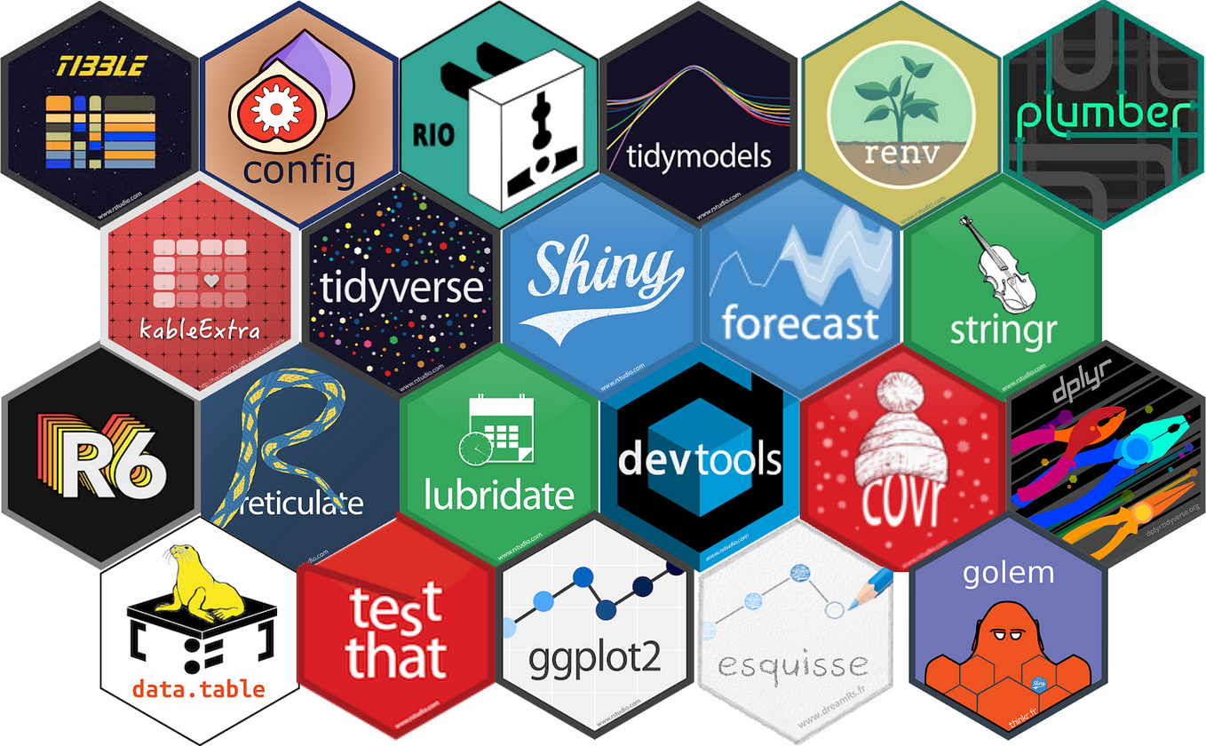
Why Share Your R Package?
Increase visibility and scientific impact
Open your work to feedback
Support Open Science principles
Enable discoverability and interoperability with Bioconductor

Slide 4
Package Readiness Checklist

Slide 5
Is Your Package Ready to Share?
Consistent function naming and structure [covered]
Documentation and examples for all exported functions [covered]
Clean, working code with clear purpose
Version control (e.g., Git/GitHub)
License and README file included

Slide 6
Testing and Validation
Unit testing is an important aspect of R package development.
“Units” = Functions
Verifies correctness of package functions with small examples
Test “paths” of internal code
Easy to implement & automate with testthat
Integrated into R CMD Check
Write functions
Write unit tests
Run tests locally
Check code coverage
R CMD Check

Slide 7

Why Use Unit Tests?
Catch bugs early!
Ensure code reliability in different use cases
i.e. different argument types
Help collaborators understand expected behavior
Create additional examples

Slide 8
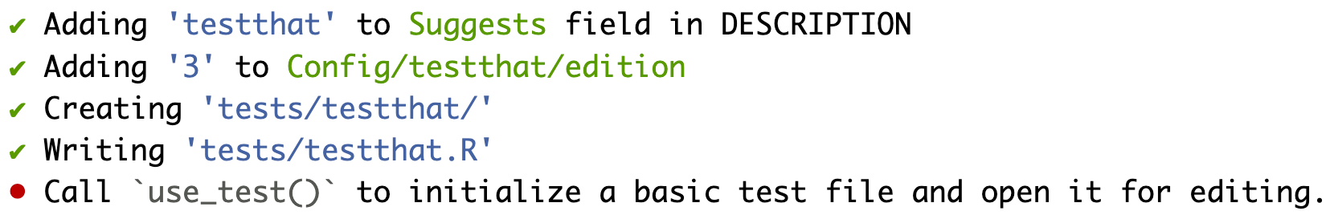
Setting up Unit Testing
Use usethis::use_testthat() to setup testing infrastructure
Use usethis::use_test("function_name") to create a test script in tests/testthat/

Slide 9
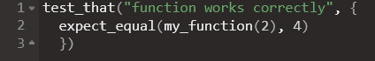
Writing Unit Tests
Use test_that() blocks to define expectations:
More info:
https://contributions.bioconductor.org/tests.html

Slide 10
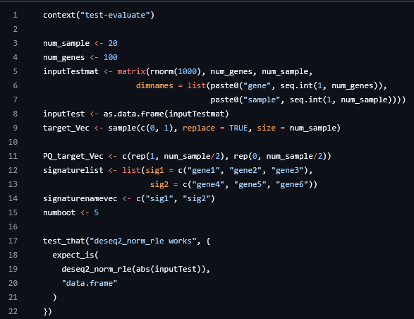
Structure
context() is deprecated; don’t use it
Set up some sort of test case to use for all tests,
Can use fake data
What are you testing? (name the test)
In this case: check that the function returns a specific output (a data.frame)

Slide 11
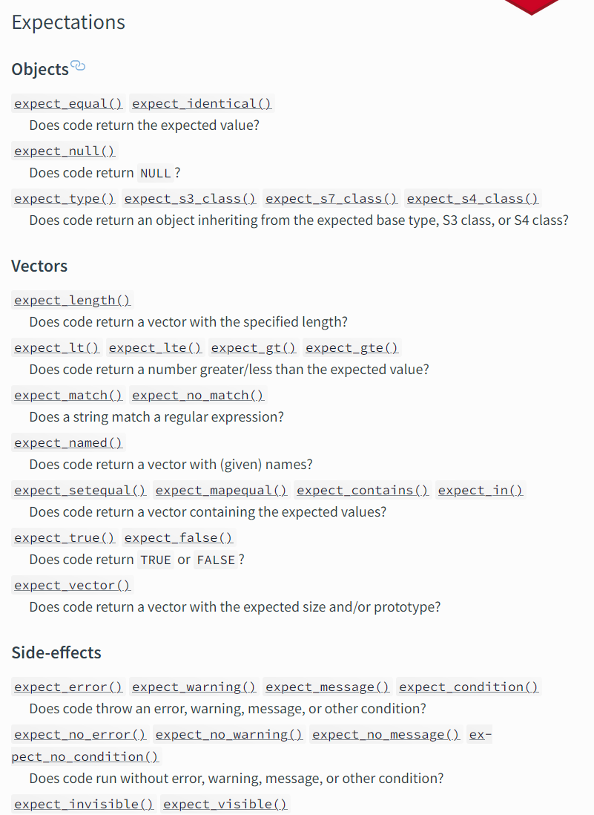
Expectations
For a comprehensive list, check out testthat’s documentation:
https://testthat.r-lib.org/reference/index.html#expectations

Slide 12
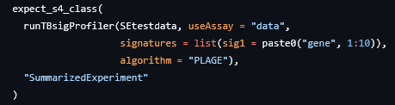
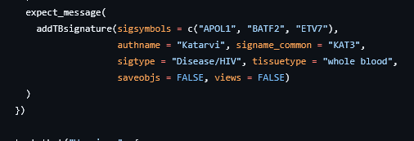
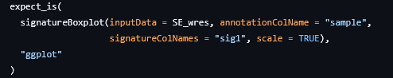
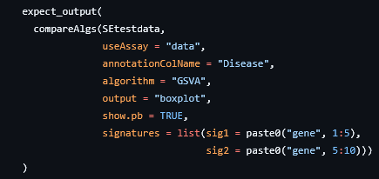
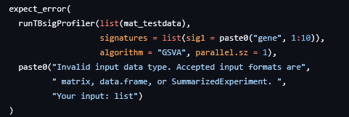
Examples of “Expectations”
Full examples:
https://github.com/wejlab/TBSignatureProfiler/tree/devel/tests/testthat

Slide 13
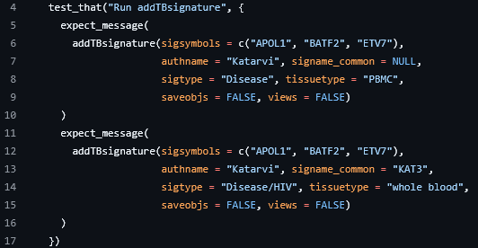
Grouping expectations
You can group multiple expectations together – for example, for one function or an aspect of a function

Slide 14
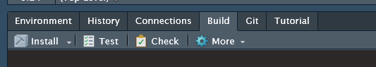
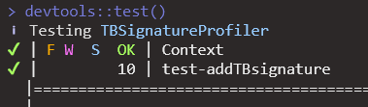
Running Unit Tests
Running your tests is easy-peasy:
Options:
Using the Test button in the Rstudio Build pane
As part of R CMD CHECK
Run devtools::test()

Slide 15
Package Testing “Coverage”
How much of my package is covered by my unit tests?
Option 1: Look at coverage for a specific script
test_for_me <- function(codefile, testfile) { test_file(testfile) res <- covr::file_coverage(codefile, testfile) print(res) covr::report(res)
} test_for_me("R/evaluate.R", "tests/testthat/test-evaluate.R")

Slide 16

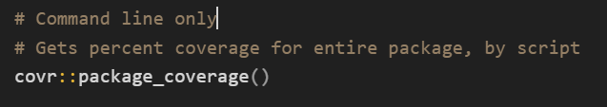
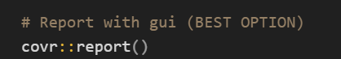
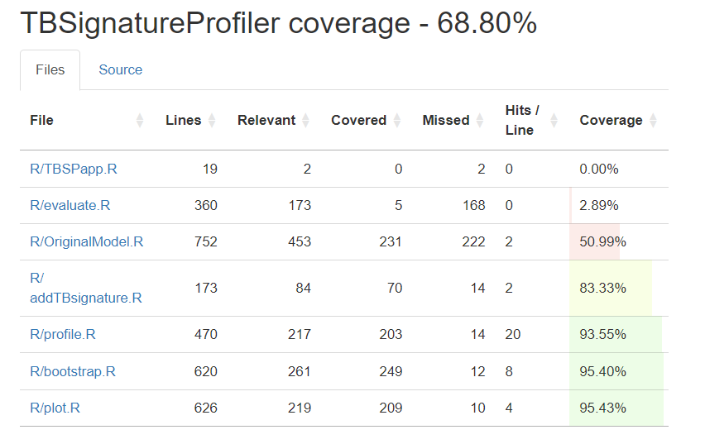
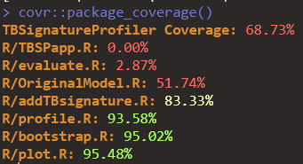
Testing Coverage cont.
Option 2: Look at the entire package coverage
Option 2a (less informative, fast)
Option 2b: AWESOMENESS

Slide 17
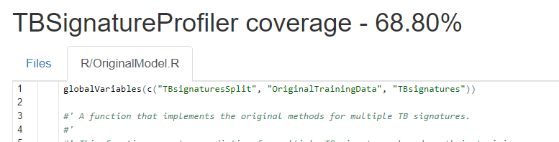
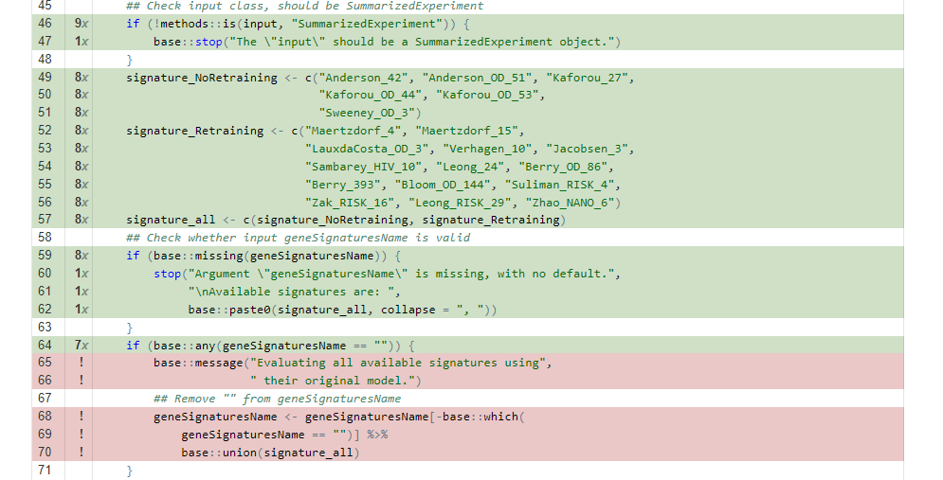
Unleashing covr::report()
Click on a file in the “files” tab
The full file will open in the GUI
🎯The game:
Get coverage up to 100%!
✅ Tests exist that “hit” all of these lines!
❌ Tests need to be written that specifically trigger these cases or messages.

Slide 18
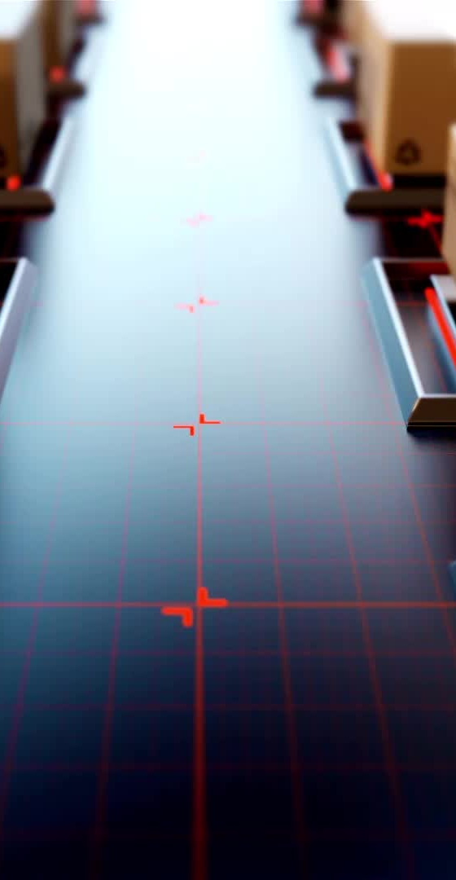
Unit Testing Limitations
Takes longer to run during package checks
Not always applicable with memory or time intensive functions
Requires effort to write and update
Difficult to test external dependencies

Slide 19
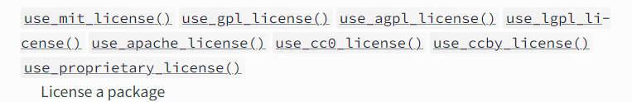
Licenses
Defines how others can use, modify, and distribute your code
Common License Options
Core Bioconductor packages are typically licensed under Artistic-2.0
MIT: Simple and permissive; allows reuse with attribution
GPL-3: Strong copyleft; requires derived works to also be open source
Apache 2.0: Permissive with explicit patent rights
How to Add a License
usethis::use_<type>_license("Your Name")
License file is added to the root of your package
Full list of options
https://contributions.bioconductor.org/license.html

Slide 20
Writing Vignettes

Slide 21
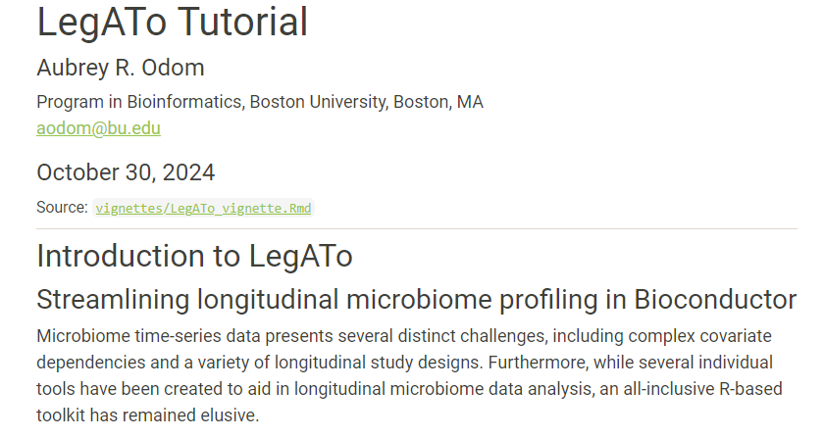
What is a Vignette?
Narrative document that demonstrates how to use your package
Acts as a tutorial or guide
Located in vignettes/ folder
Shows real-world usage
Explanations
Code examples
Interpretations
Workflows

Slide 22
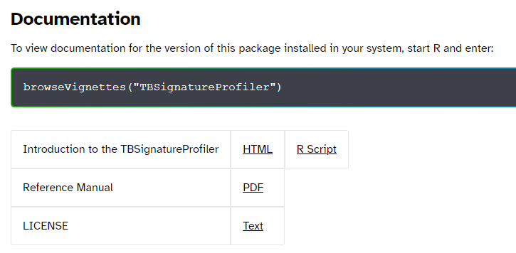
Vignette Examples
https://github.com/wejlab/TBSignatureProfiler/blob/devel/vignettes/rmd/TBSig_Vignette.Rmd
https://github.com/wejlab/MetaScope/blob/devel/vignettes/MetaScope_vignette.Rmd
https://github.com/wejlab/LegATo/blob/devel/vignettes/LegATo_vignette.Rmd
https://bioconductor.org/packages/release/bioc/html/TBSignatureProfiler.html

Slide 23
Bioc Vignette Considerations
Vignette is required
Rmd, quarto or Sweave
BiocStyle::html_document
Non-trivial, executable code
Bioc must install & run checks in <10 min
If needed, make the package vignette shorter, and your MkDocs website vignette longer / heavier in computation
Real-world applications but small example dataset

Slide 24

Creating a pkgdown Website

Slide 25
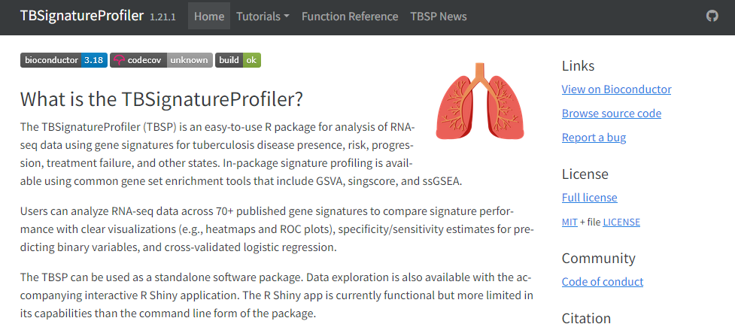
pkgdown: Taking Your Docs to the Next Level™️

Slide 26
Why Use a Docs Website?
Centralized & accessible package documentation for:
Installation
Tutorials
Functions
Examples (already run w/ output!)
Citation info

Slide 27
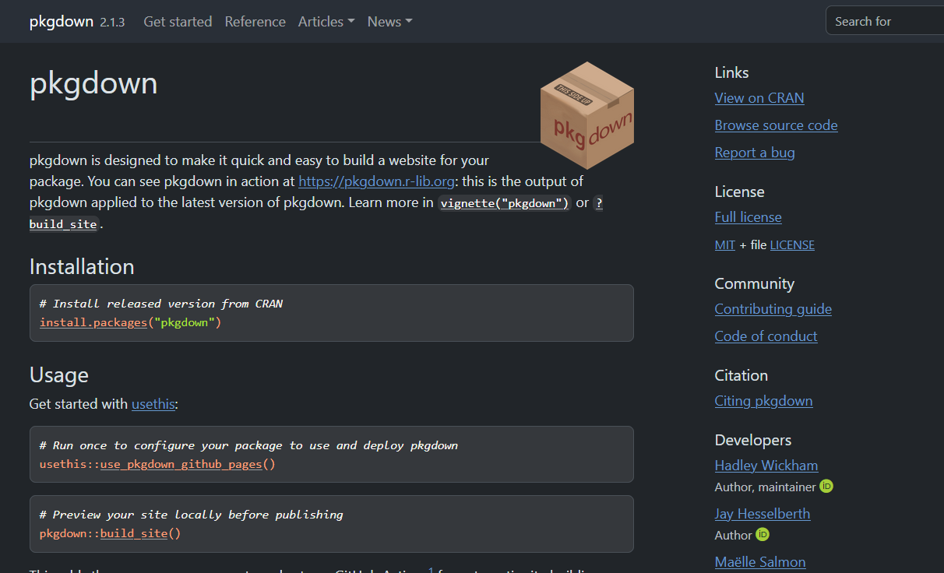
Why Use pkgdown?
Integrates with R Workflow
Improves accessibility for scientists of various backgrounds
Modern theming
Easy deployment to GitHub pages
Customizable themes and plugins
Widely used and actively maintained

Slide 28
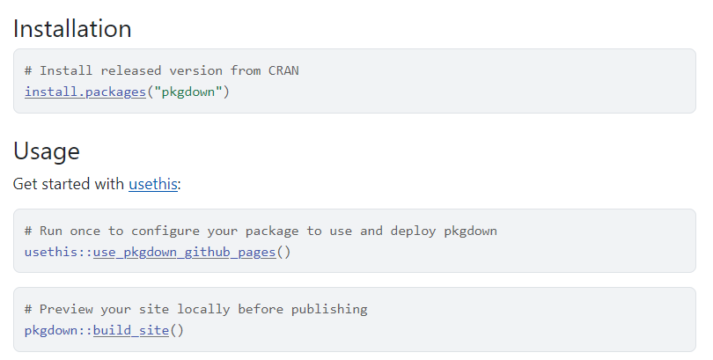
Setup
Creates a _pkgdown.yml file and sets up GitHub Actions for automating deployment

Slide 29
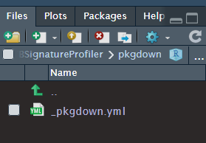
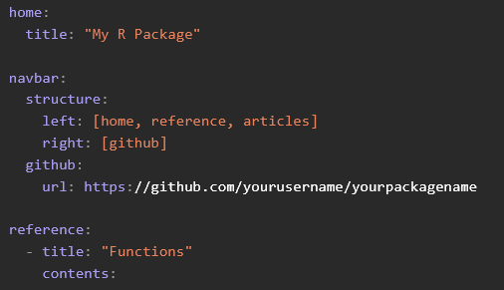
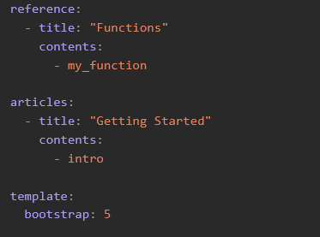
Customize Your Site
Edit _pkgdown.yml
I usually create a new pkgdown/ folder for easier organization
https://pkgdown.r-lib.org/articles/customise.html

Slide 30
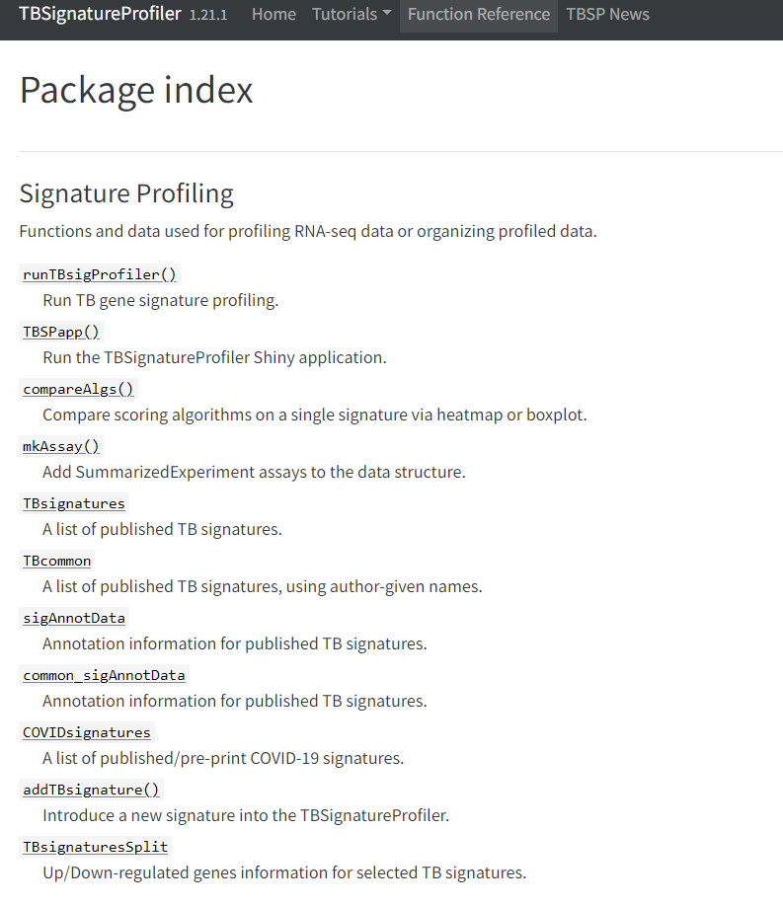
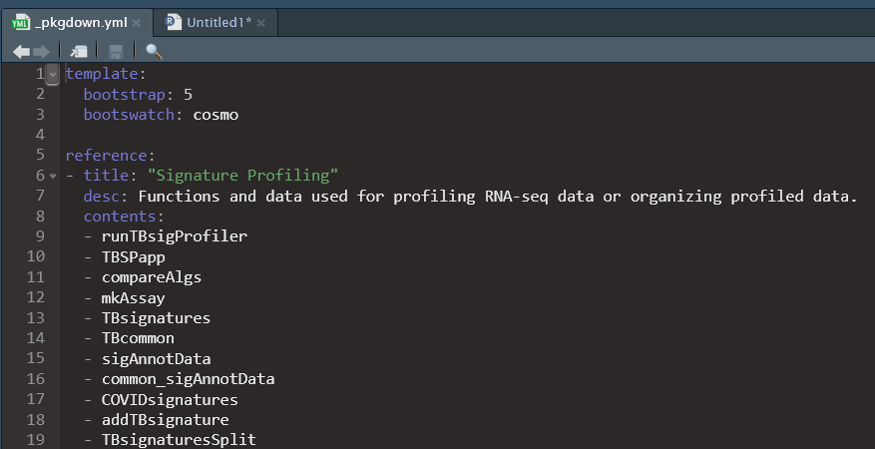
YML: Theme and Reference
https://rstudio.github.io/bslib/
For site themes & styles!
Your function docs can be ordered into whatever categories you’d like --->

Slide 31
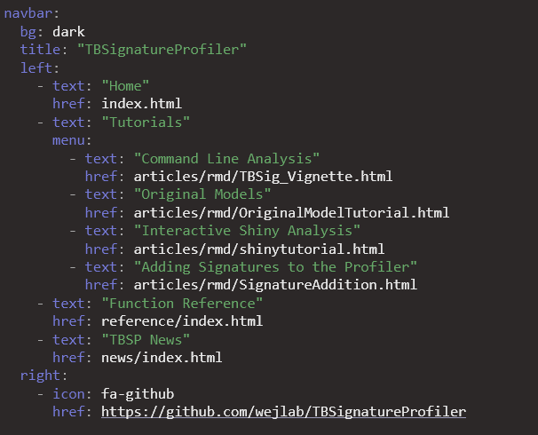
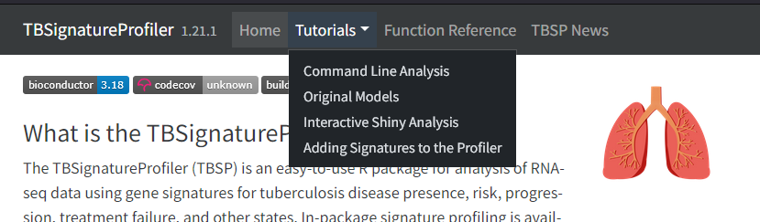
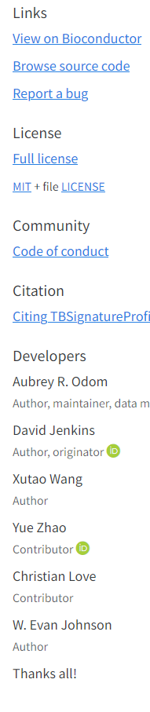
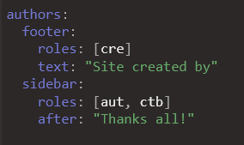
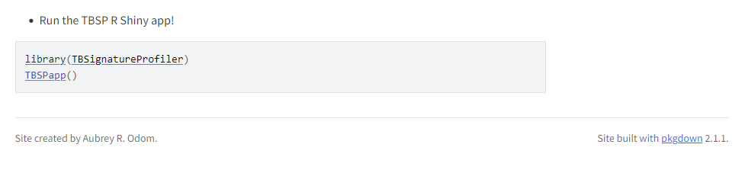
YML: Navbar
Create page tabs and sub-menus
Top navbar
Must point to built articles
Site footer
Side navbar

Slide 32
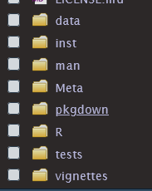
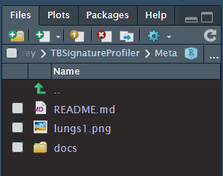
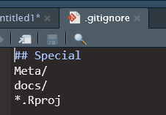
A Note on Organizing Files
The R CMD CHECK will not like the extra files produced by pkgdown (YML is OK)
[homepage]
The new folder has been set to not be tracked by .gitignore
This avoids CHECK issues!
[built site]
To avoid this, create a new folder and store the files there
This is where I store the homepage, and docs will auto-populate

Slide 33
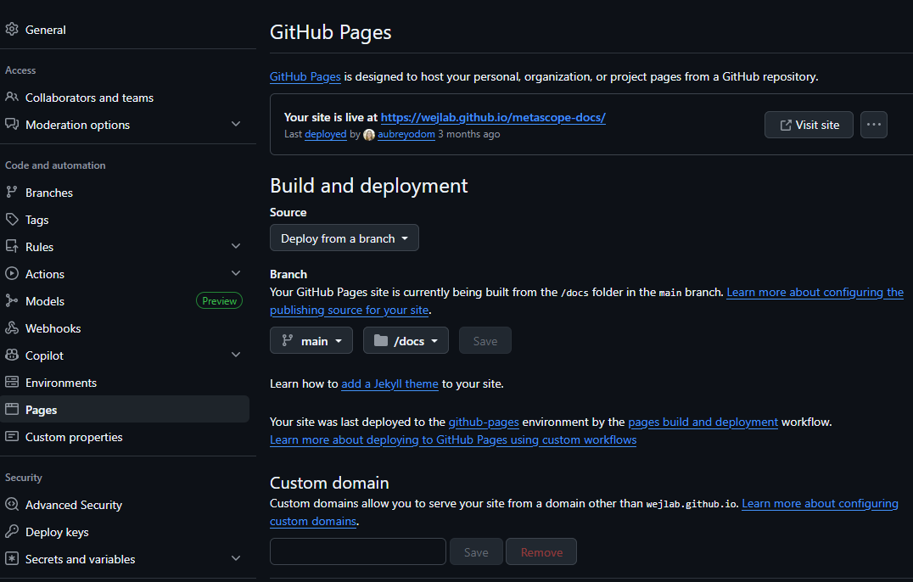
Set up Docs GitHub repo
You will need to separately set up a docs repository *just* for the built files!

Slide 34
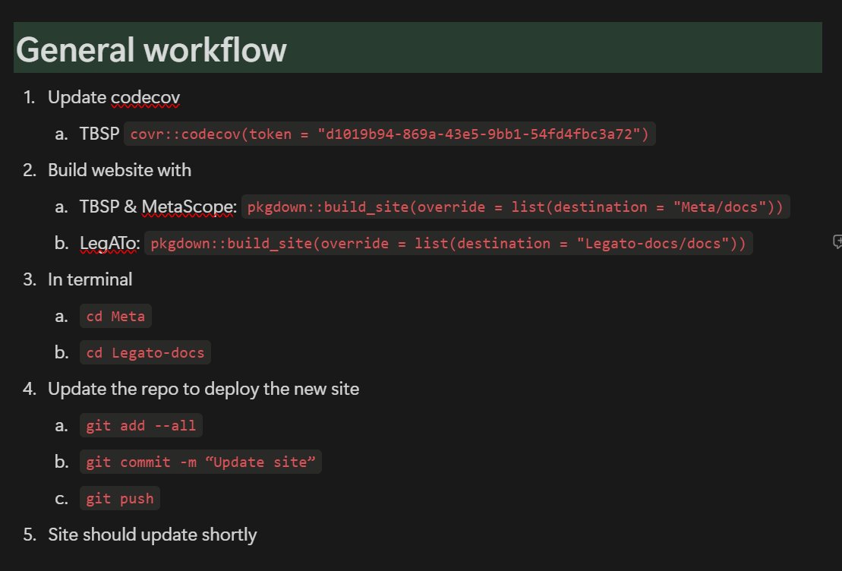
Building and Deploying
[optional] Brag about package unit testing coverage
Build site to that new folder you made
Push to the repo to trigger a new site build

Slide 35
Examples
🫁TBSignatureProfiler
_pkgdown.yml
Website
Docs GitHub repo
🦠animalcules
_pkgdown.yml
Website
Docs GitHub repo
🔬MetaScope
_pkgdown.yml
Website
Docs GitHub repo
📈LegATo
_pkgdown.yml
Website
Docs GitHub repo
Also see curatedTBExplorer and sctk on wejlab GitHub

Slide 36
Bioconductor Submission Prep

Slide 37
R Package Repositories
A Central Hub for R Packages
A repository stores, distributes, and manages R packages for users and developers.
Types of Repositories
CRAN: The official R repository for general-purpose packages
Bioconductor: Specialized in bioinformatics and computational biology
GitHub/GitLab: Used for development, collaboration, and early access
Why It Matters
Enables easy installation via install.packages() or BiocManager::install()
Ensures version control, dependency management, and reproducibility
Facilitates discovery and citation of your work

Slide 38

Submitting to Bioconductor
Bioconductor has many expectations and requirements
They provide a helpful online resource that you will need to peruse as you finish up development
Otherwise your assigned reviewer will be Very Annoyed

Slide 39
Bioc Requirements
You will want to read this document before submission:
https://contributions.bioconductor.org/bioconductor-package-submissions.html
I will mention a few relevant aspects on the following slides and where to find that info
But seriously, read that documentation ^^

Slide 40
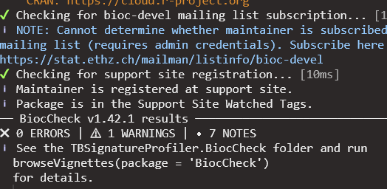
Passing BiocCheck
On top on R CMD Check you will need to pass BiocCheck::BiocCheck()
This is only required to pass review
Not needed after that (maintenance)
No ERRORS or WARNINGS, but NOTES are OK

Slide 41
Integration w/ Existing Bioc Packages
https://contributions.bioconductor.org/important-bioconductor-package-development-features.html
Basically, minimize new object class development and use packages like SummarizedExperiment or MultiAssayExperiment where possible

Slide 42
DESCRIPTION Requirements
You will need to specify your package type
BiocCheck will try to help identify appropriate tags
https://contributions.bioconductor.org/bioconductor-package-submissions.html
https://contributions.bioconductor.org/description.html

Slide 43
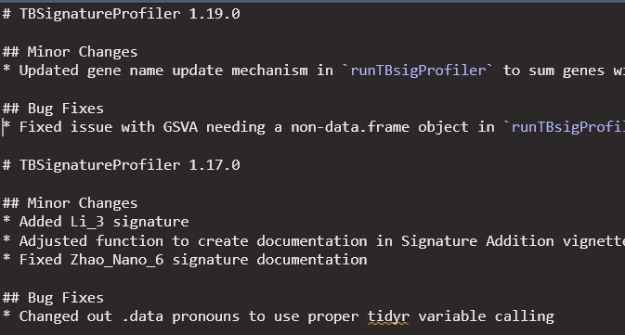
NEWS Requirements
https://contributions.bioconductor.org/news.html

Slide 44
Citing your Package
If you have a publication associated with your package, you should include that information with your documentation
https://contributions.bioconductor.org/citation.html

Slide 45
Including Data
There are many types of data that you can include in your package
Those expectations and folders for the types of data can be complicated…
There are also packages explicitly for curated data
E.g. curatedTBData
https://contributions.bioconductor.org/data.html

Slide 46
Bioconductor Review Process

Slide 47
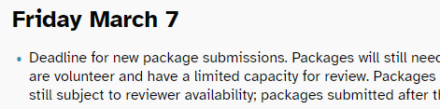
Are You Ready?
Ideally, you will have done everything discussed up to this point
Volunteer Reviewer will note anything missing
Short review window -> best to preemptively finalize package before submission
Avoid last-minute headaches
Bi-annual new package submission deadlines:
March
September
https://bioconductor.org/developers/release-schedule/

Slide 48
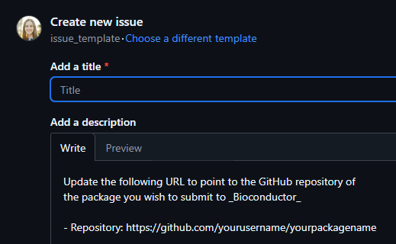
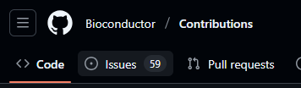
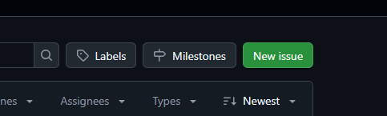
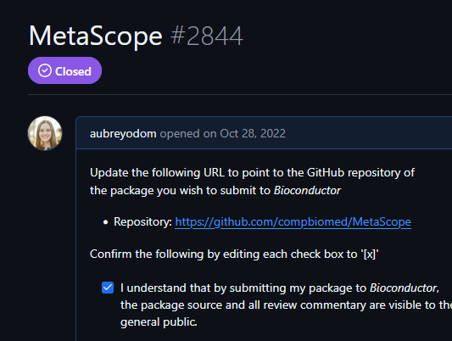
1. Initial Submission
3. Read the agreement; add your repo link; type an x for each item
Title will be the name of your package
1. Go to the Bioconductor New Package Tracker
4. Submit issue
2. Create a new issue

Slide 49
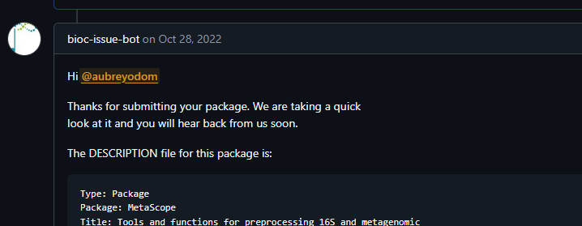
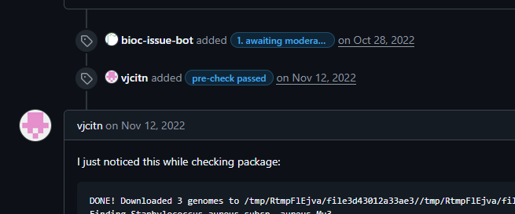
2. Preliminary Check
Someone from the Bioc team will quickly snoop around your code before handing off to a reviewer
They will note if there are any glaring issues

Slide 50

3. Automated Checks
Once a reviewer is assigned, your package will be added to the automated builder
Your package is automatically checked for:
Build errors/warnings
Code formatting and documentation
Bioconductor best practices
You will need to set up the “upstream” to push to the Bot (see instructions)
Keep fixing and pushing until it successfully passes
NOTE: be sure to update the version number each time you push to trigger a new build

Slide 51

4. Review Process
Volunteer Reviewer will come through and check your code against all those Bioconductor requirements
Typically these are styling or usability issues
You will need to reply to each of their comments
Clearly didn’t know what “Enhances” in DESCRIPTION meant lol

Slide 52

5. Acceptance
Finally after (hopefully a few) back-and-forth comments you’ll get a PASS!

Slide 53
Examples
MetaScope
LegATo
singleCellTK
PathoStat
curatedTBData
animalcules
TBSignatureProfiler

Slide 54
Package Maintenance

Slide 55

Maintenance starts at Package Acceptance
Read through the “acceptance” message for important info on
Setup of SSH keys
Upstream branch updates
Syncing Bioconductor and package development repo

Slide 56


Checking builds
Release version
Devel version
https://bioconductor.org/checkResults/3.21/bioc-LATEST/TBSignatureProfiler/
https://www.bioconductor.org/checkResults/devel/bioc-LATEST/TBSignatureProfiler/
You will mostly be checking this one

Slide 57


Slide 58
When to update
Update ~1 month in advance of release (typically April and October)
Be sure to pull changes from upstream at time of release
This is a version number bump
Run devel checks frequently
If a build has problems you will get an angry email to fix it
If your release build starts having issues there is a way to fix it on the release branch
https://contributions.bioconductor.org/git-version-control.html#bug-fix-in-release-and-devel

Slide 59

“This is very problematic”

Slide 60

Need help?
You literally have to reply to this mailing list
Your issue will show up on the mailing list the next day
People will respond with solutions
All package maintainers will now know your problem
The advantage: You could chime on other peoples’ problems if you know the answer 🤡

Slide 61

Maintainer Lifestyle
“I have so many project deadlines coming up”
“Oh {}%4$!! I need to fix these errors before the release deadline on Friday night”
“Ugh the builds only happen like once every two days so I have to install the Bioconductor docker on my computer because the SCC only allows Singularity”
“FML”
“please don’t deprecate my package”
“OK fixed that, now back to my real work that I am actually paid for”

Slide 62


Slide 63
Wrap up

Slide 64
Conclusions
Package maintenance is a low-prestige, undervalued task
It can be lonely and incredibly confusing/frustrating at times
But at the end of the day… hopefully this R package makes your others’ analyses easier

Slide 65

Q & A

